Slide 1





SQL PROJECT ON
Music Store Data Analysis
PRESENTED BY:- JAY KADU

Slide 2
Objective
This project aims to explore the music store database to generate key business insights using SQL. The primary objectives are:
🔍 Employee Insights
🌍 Geographic Analysis
💰 Customer & Revenue Analysis.
🎶 Music & Genre Insights
🌎 Genre Popularity by Country

Slide 3


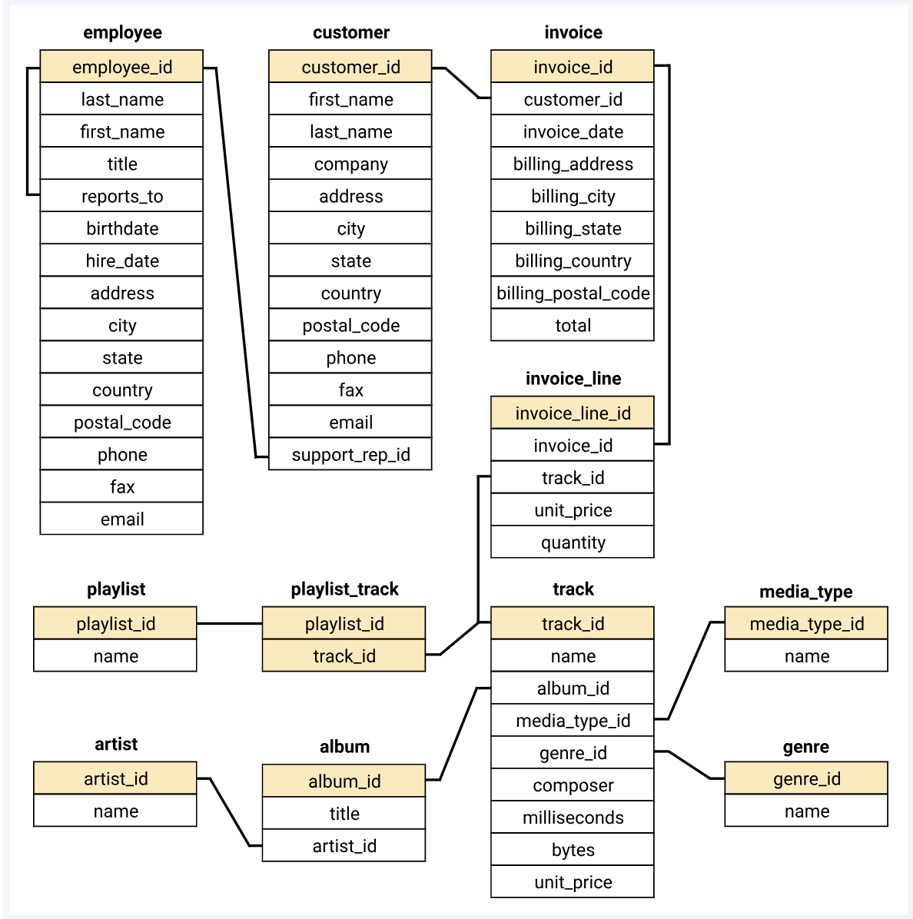
Er Diagram

Slide 4
Database schema overview
Table Name | No. of Columns | No. of Rows | Primary Key | Foreign Key(s)
employee | 13 | 9 | employee_id | Reports to → employee.employeeid
customer | 13 | 59 | customer_id | support_rep_id → employee.employee_id
invoice | 9 | 614 | invoice_id | customer_id → customer.customer_id
invoice_line | 6 | 4757 | invoice_line_id | invoice_id → invoice.invoice_id, track_id → track.track_id
track | 9 | 3503 | track_id | album_id → album.album_id, media_type_id → media_type.media_type_id, genre_id → genre.genre_id
album | 3 | 347 | album_id | artist_id → artist.artist_id
artist | 2 | 275 | artist_id | -
genre | 2 | 25 | genre_id | -
media_type | 2 | 5 | media_type_id | -
playlist | 2 | 18 | playlist_id | -
Playlist track | 2 | 8715 | Composite (playlist_id, track_id) | playlist_id → playlist.playlist_id, track_id → track.track_id

Slide 5
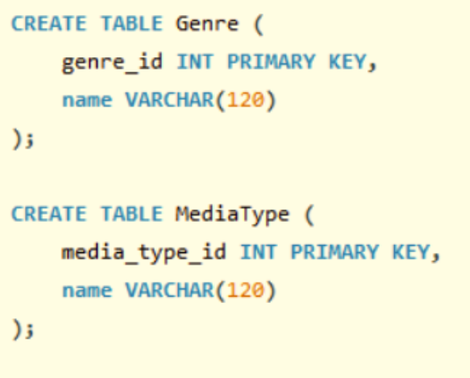
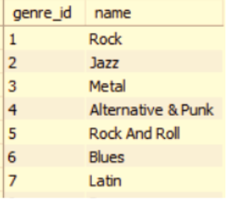
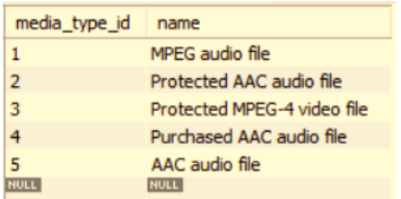
Genre and MediaType TABLE

Slide 6
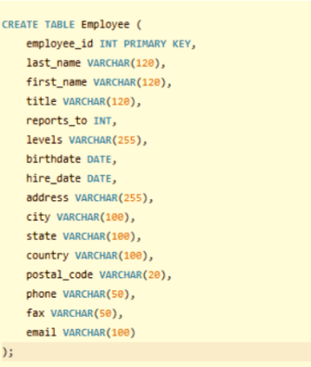
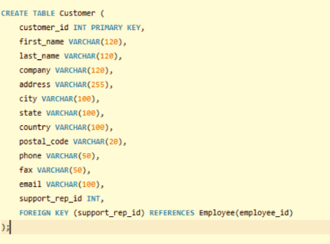
Employee AND CUSTOMER table

Slide 7
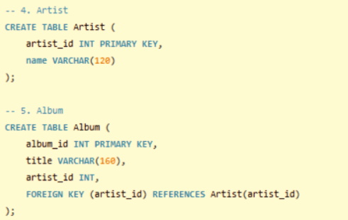
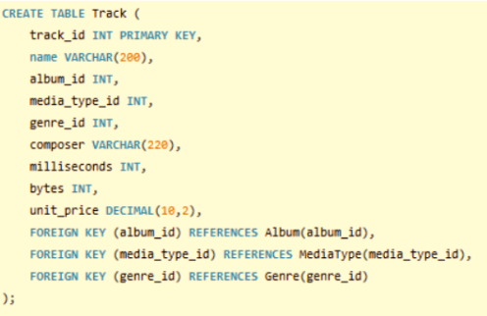
Artist , ALBUM AND TRACK table

Slide 8
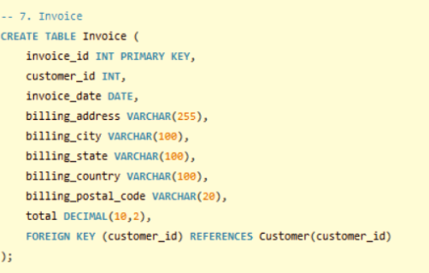
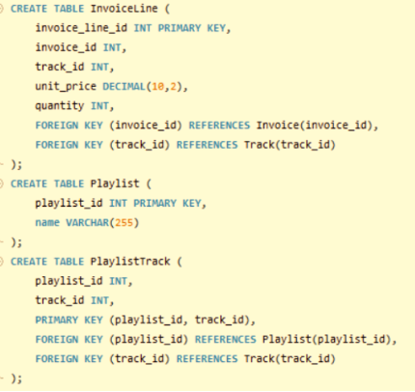
INVOICE , INVOICELINE , PLAYLIST AND PLAYLISTTRACK table

Slide 9
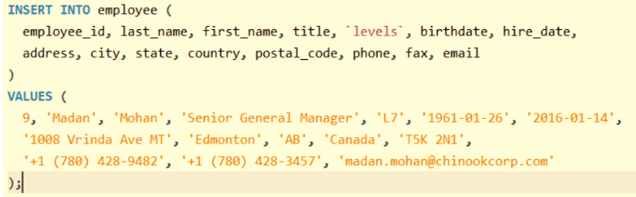
adding the missing row IN employee table

Slide 10
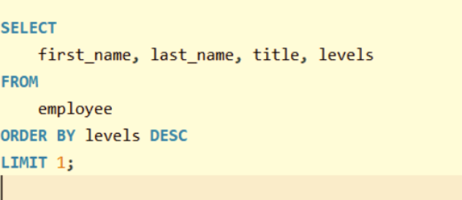

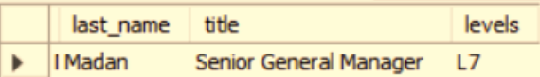
1. Who is the senior most employee based on job title?

Slide 11
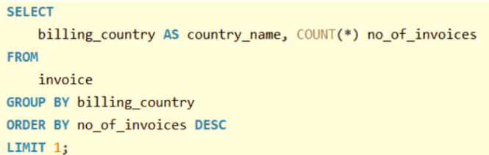
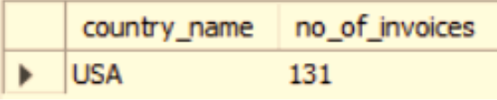
2. Which countries have the most Invoices?

Slide 12
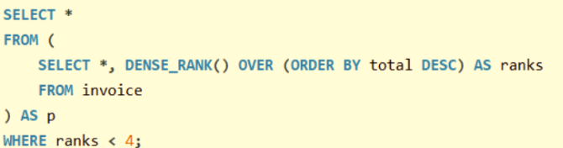
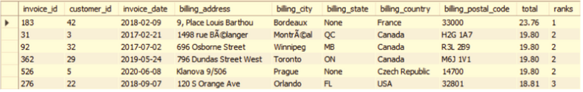
3. What are the top 3 values of total invoice?

Slide 13
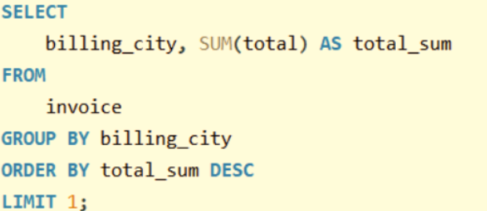
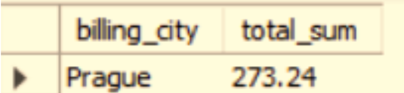
4. Which city has the best customers?
We would like to throw a promotional Music Festival in the city we made the most money. Write a query that returns one city that has the highest sum of invoice totals. Return both the city name & sum of all invoice totals

Slide 14
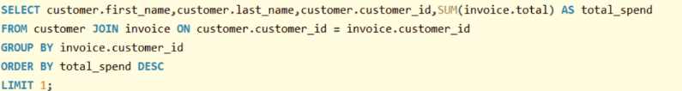
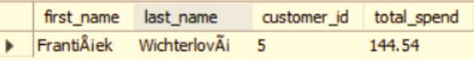
5. Who is the best customer?
The customer who has spent the most money will be declared the best customer.
Write a query that returns the person who has spent the most money

Slide 15
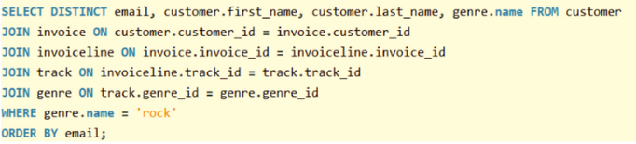
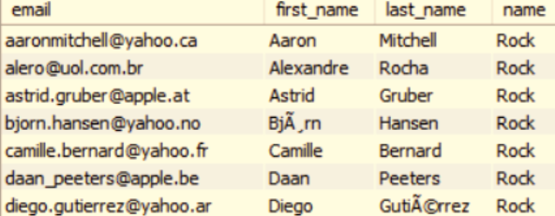
6. Write a query to return the email, first name, last name, & Genre of all Rock Music listeners. Return your list ordered alphabetically by email starting with A

Slide 16
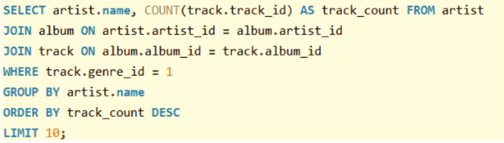
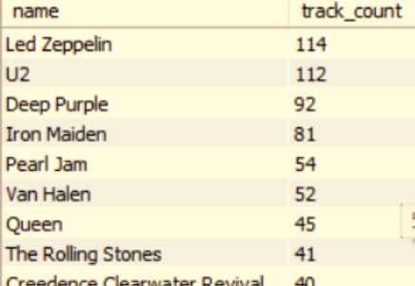
7. Let's invite the artists who have written the most rock music in our dataset. Write a query that returns the Artist name and total track count of the top 10 rock bands

Slide 17
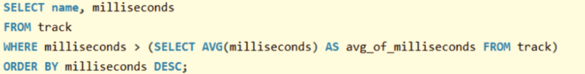
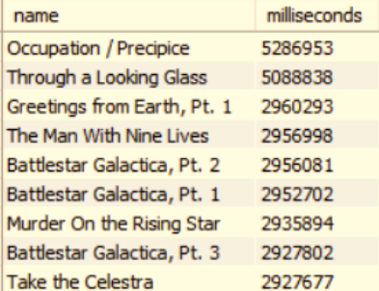
8. Return all the track names that have a song length longer than the average song length.- Return the Name and Milliseconds for each track. Order by the song length, with the longest songs listed first

Slide 18
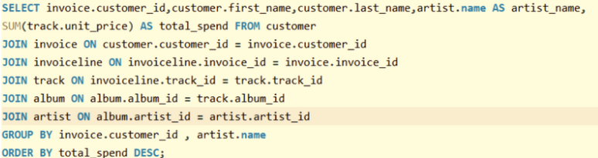
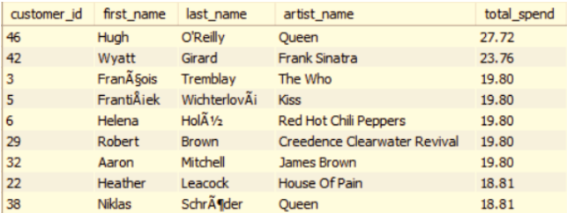
9. Find how much amount is spent by each customer on artists? Write a query to return customer name, artist name and total spent

Slide 19
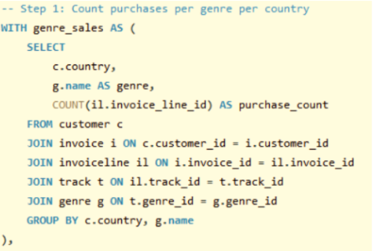
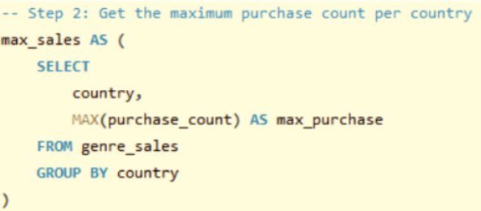
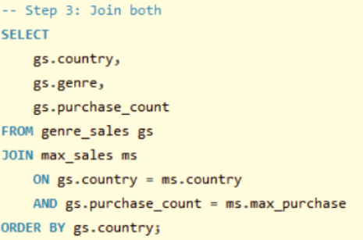
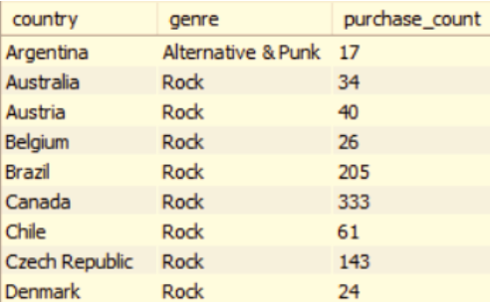
10. We want to find out the most popular music Genre for each country. We determine the most popular genre as the genre with the highest amount of purchases Write a query that returns each country along with the top Genre. For countries where the maximum number of purchases is shared, return all Genres

Slide 20
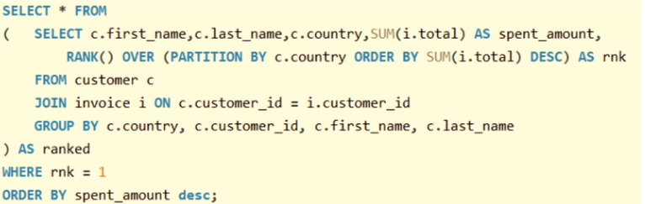
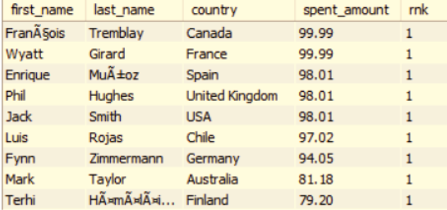
11. Write a query that determines the customer that has spent the most on music for each country. Write a query that returns the country along with the top customer and how much they spent. For countries where the top amount spent is shared, provide all customers who spent this amount

Slide 21
Business Insights
Senior-most employee
Top invoice-generating countries
Top 3 invoice values.
Best customer city
Best customer.
Rock music lovers
Top rock bands
Spending by customer on artists
Top genre per country
Top customer per country

Slide 22

Thank
you !

Slide 23

Questions ?

